Slide 2
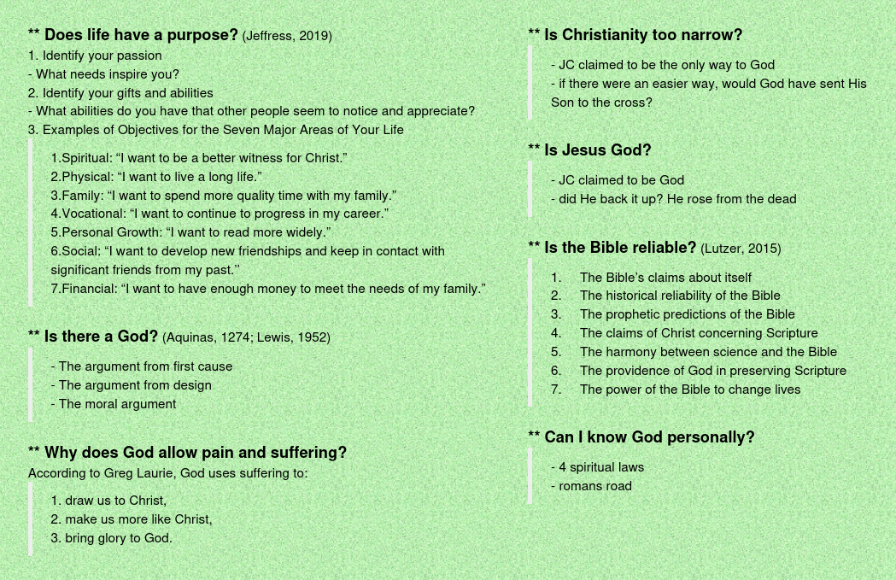

Slide 3
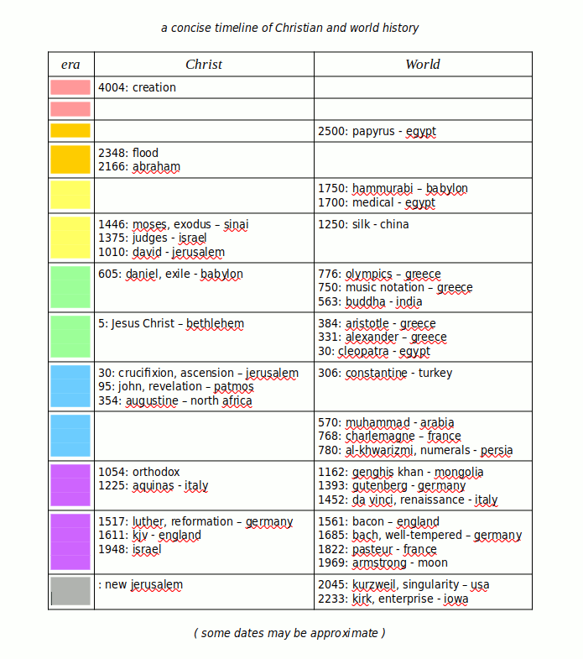

Slide 4
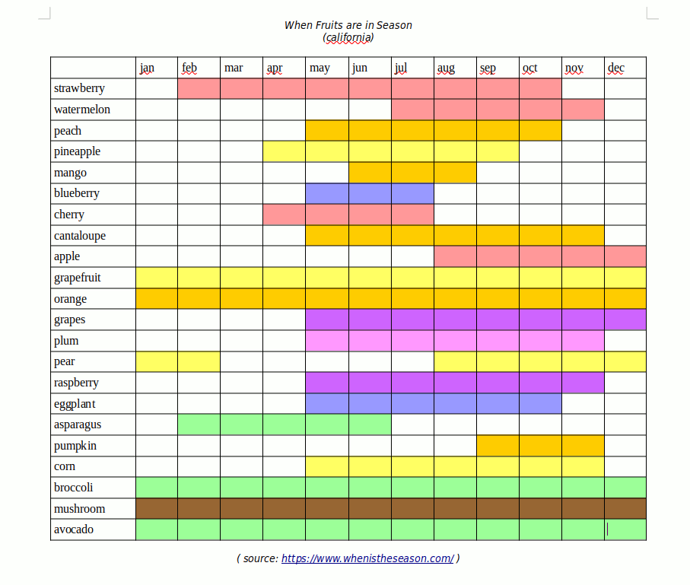

Slide 5
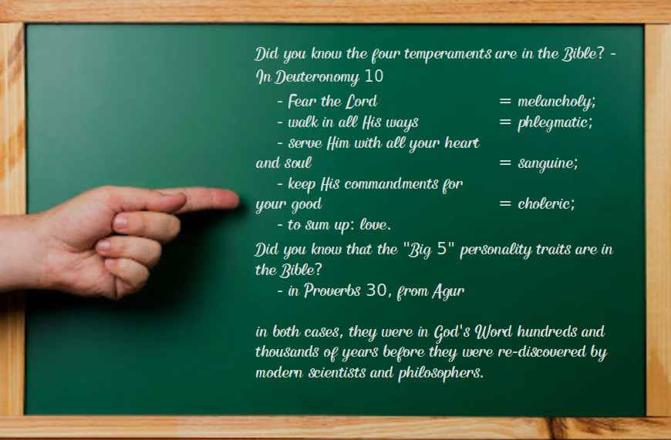

Slide 6
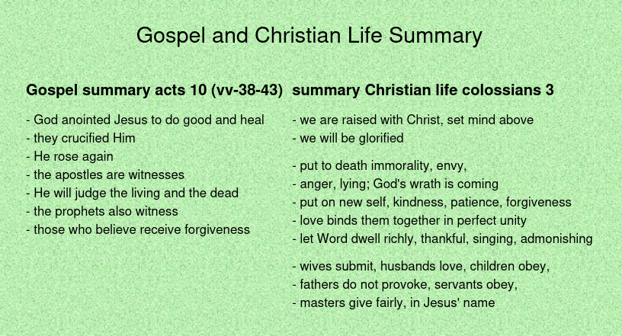

Slide 7
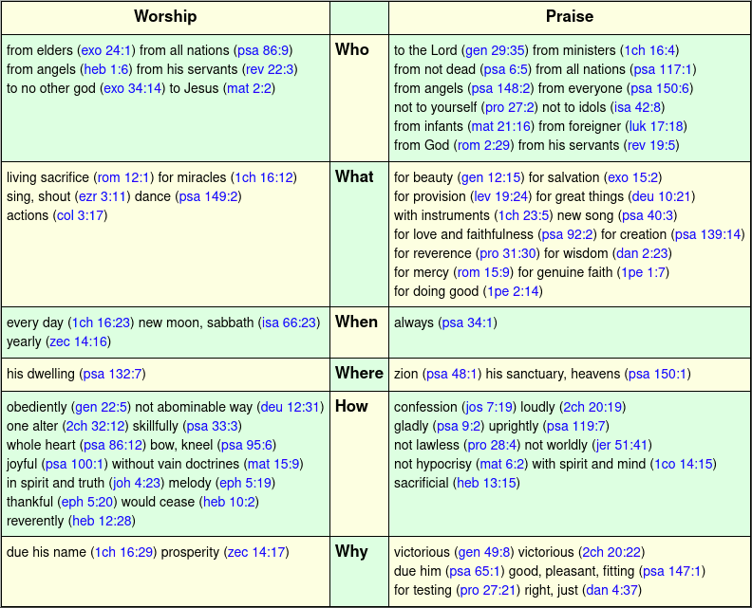

Slide 8
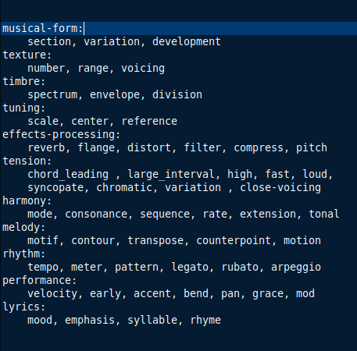

Slide 9
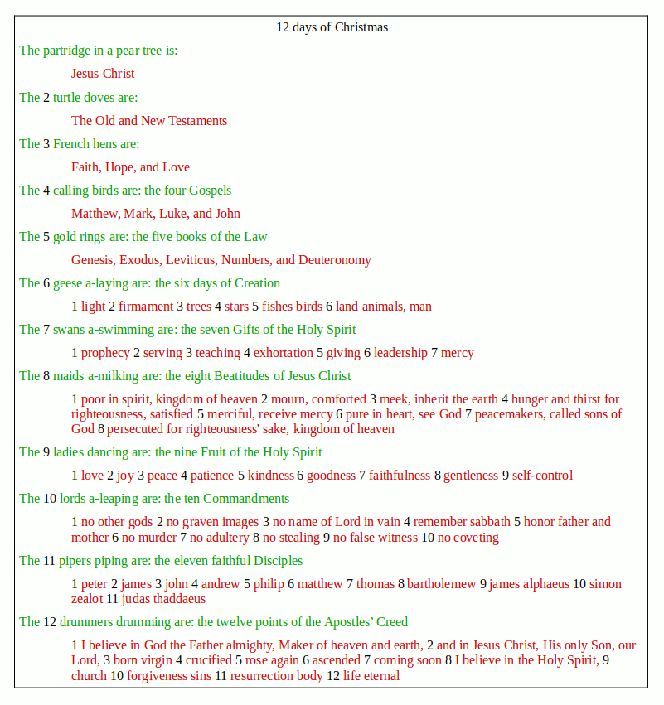

Slide 10
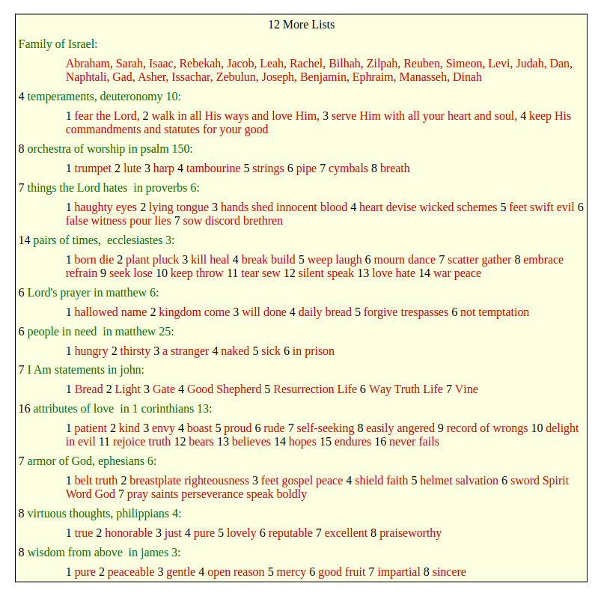

Slide 11
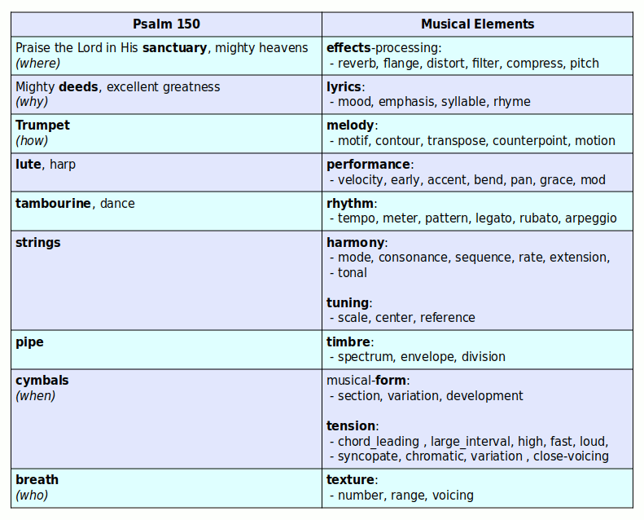

Slide 12
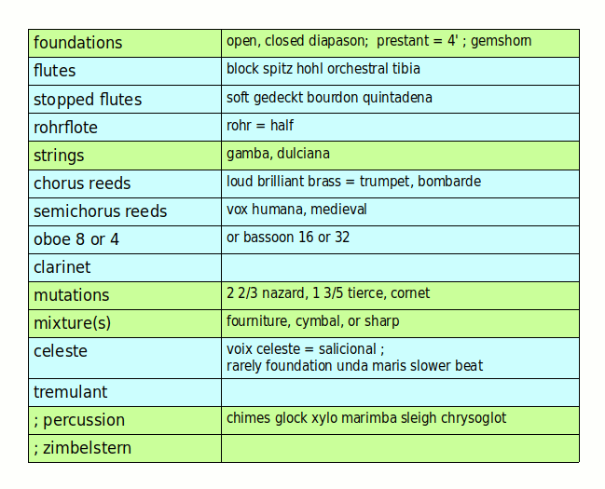

Slide 13
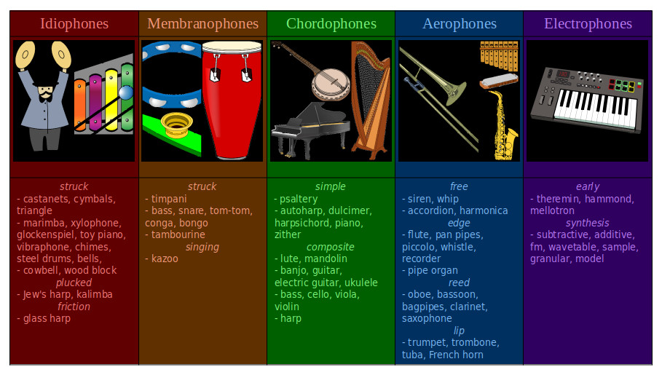

Slide 14
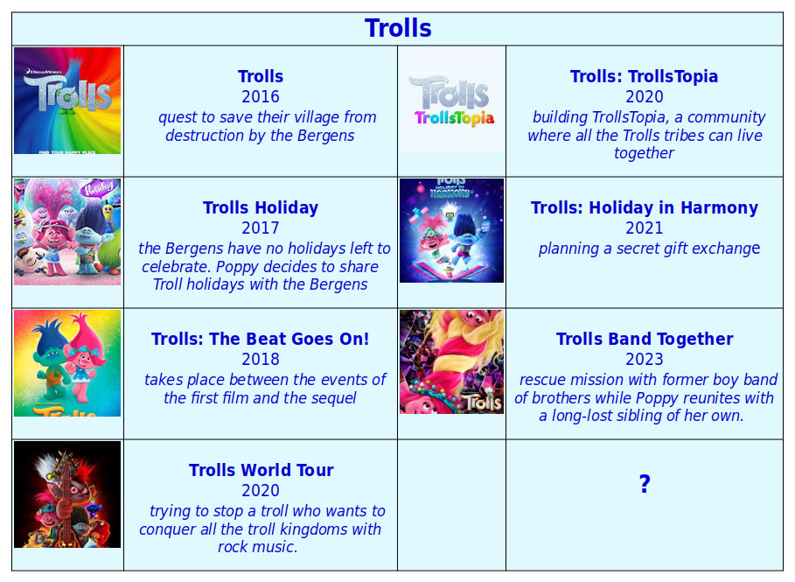

Slide 15
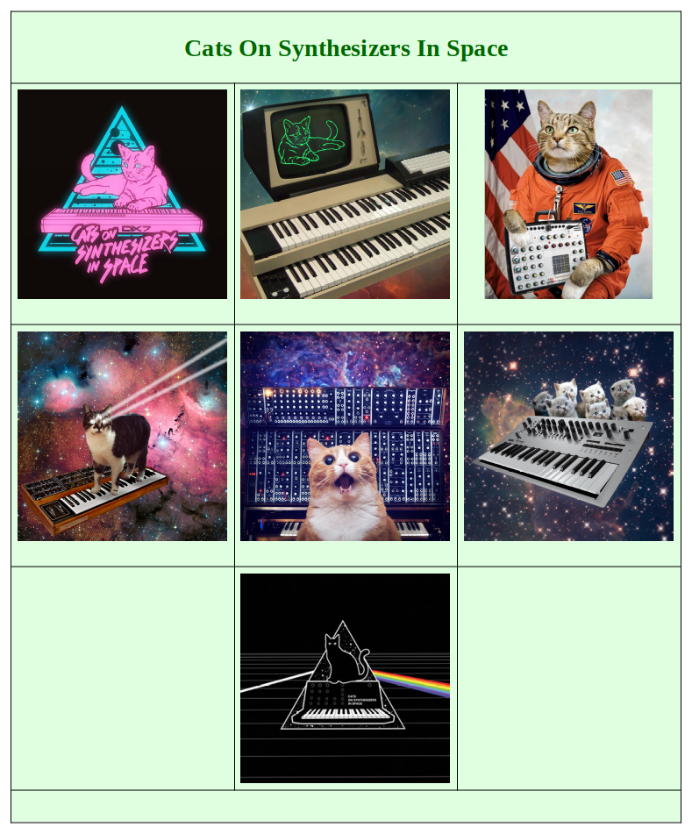

Slide 16
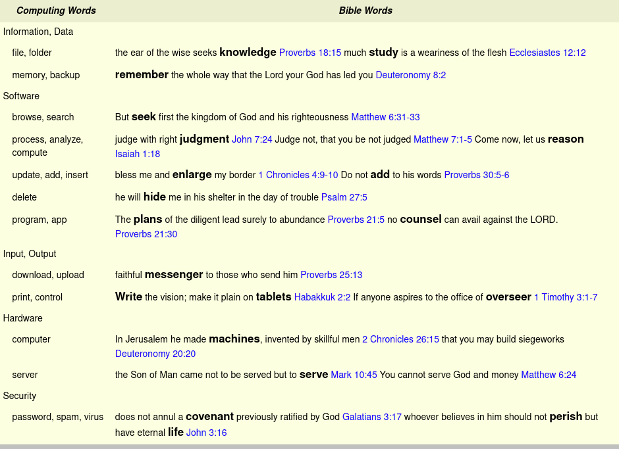

Slide 17
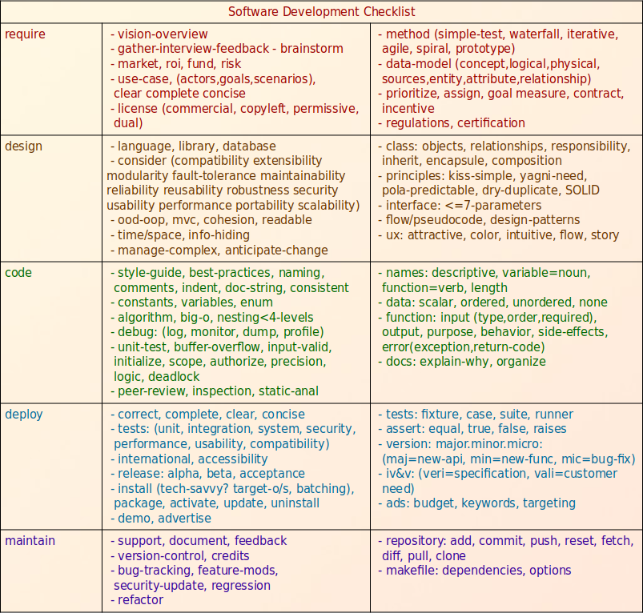

Slide 18
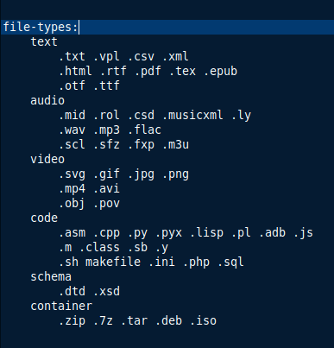

Slide 19
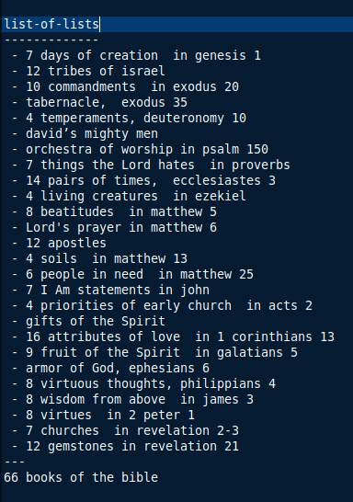

Slide 20
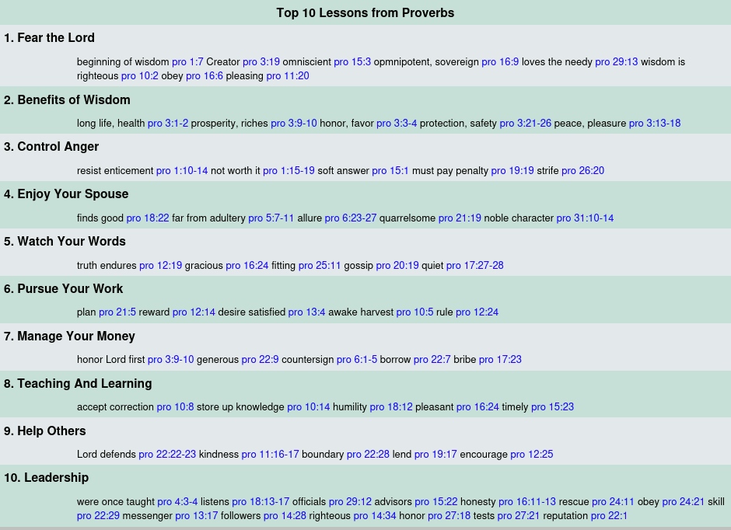

Slide 21
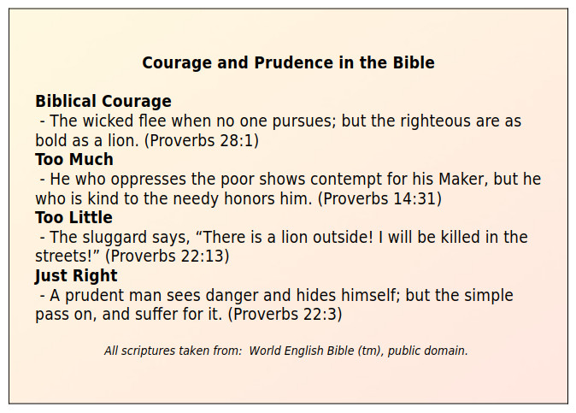

Slide 22
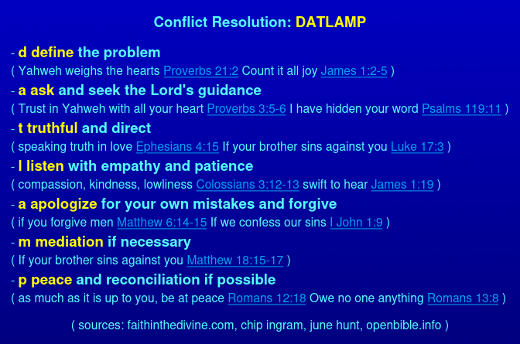

Slide 23
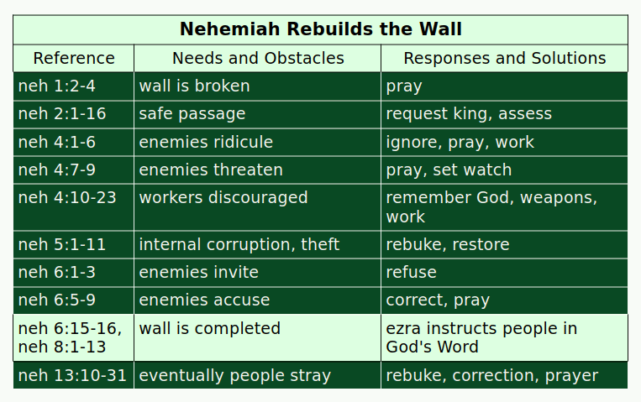

Slide 24
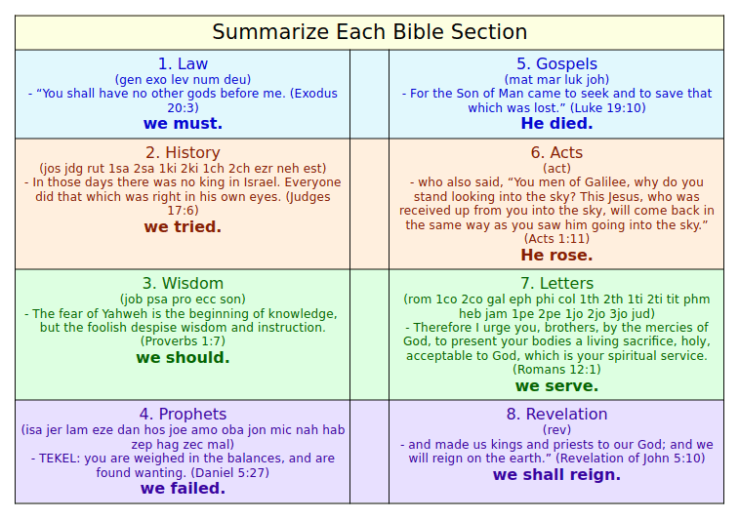

Slide 25


Slide 26
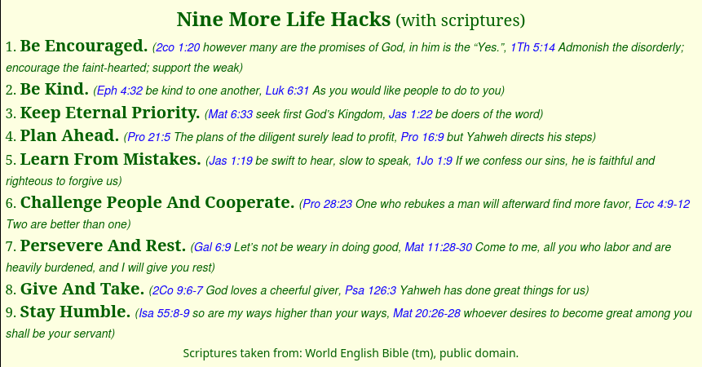

Slide 27
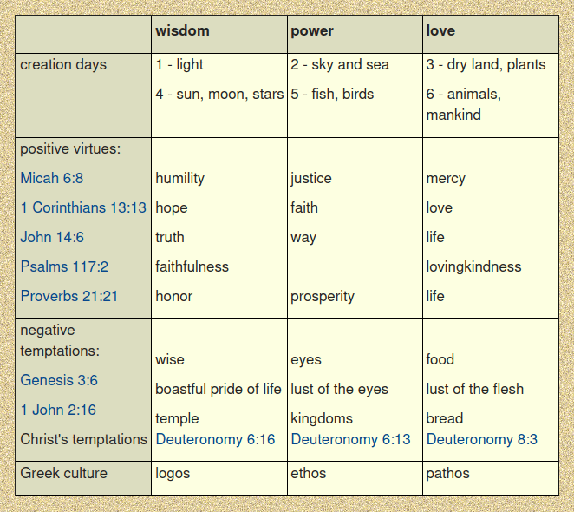

Slide 28
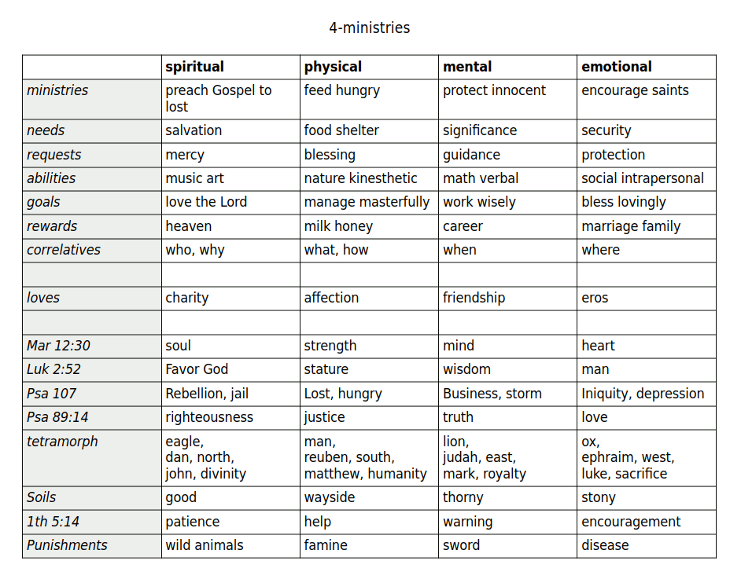

Slide 29
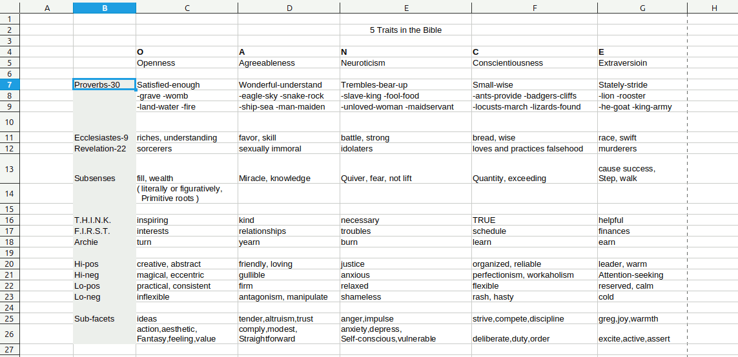

Slide 30
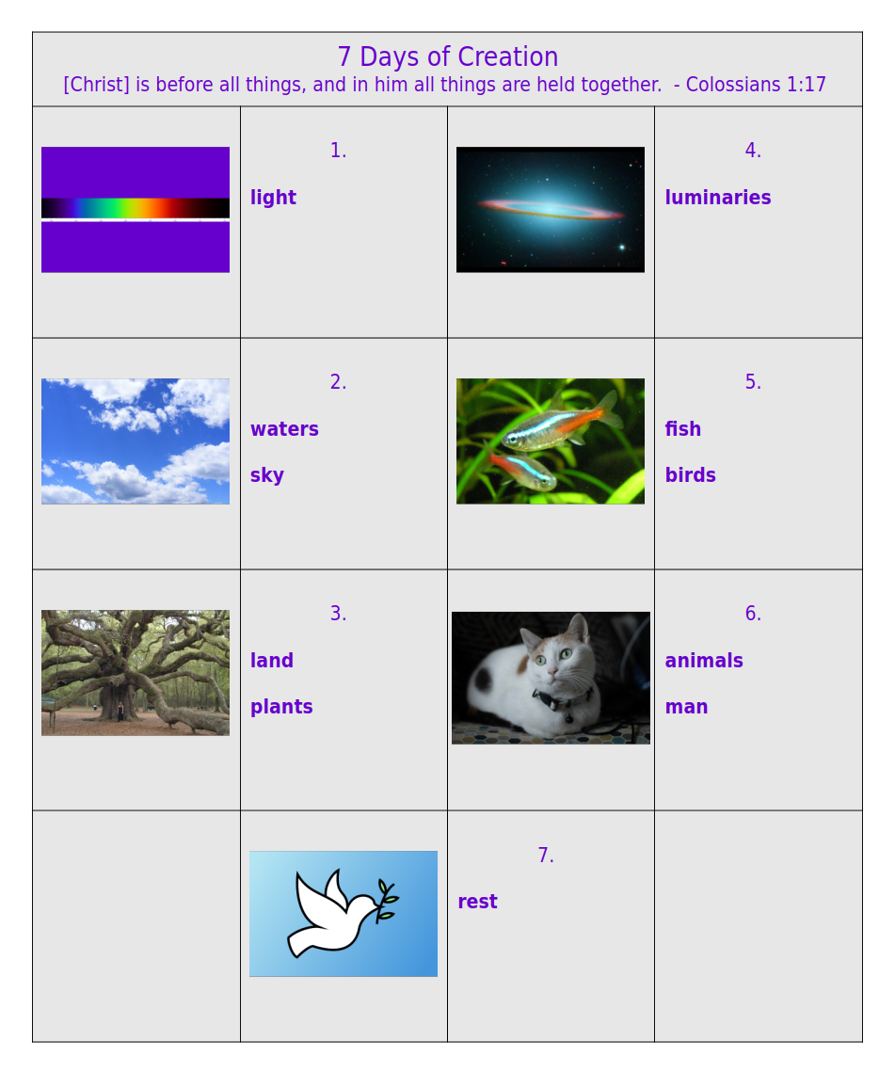

Slide 31
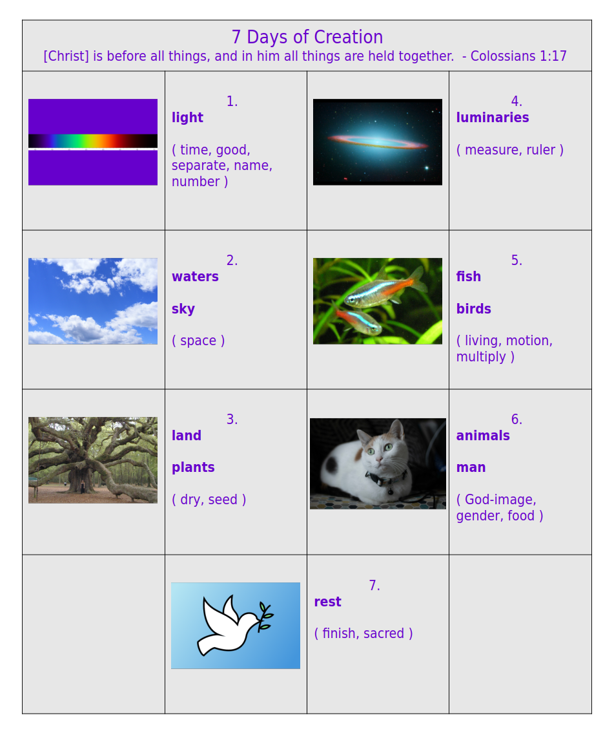

Slide 32


Slide 33


Slide 34
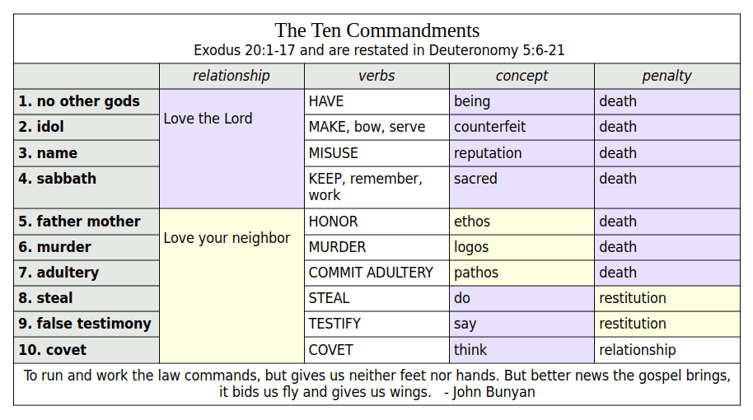

Slide 35
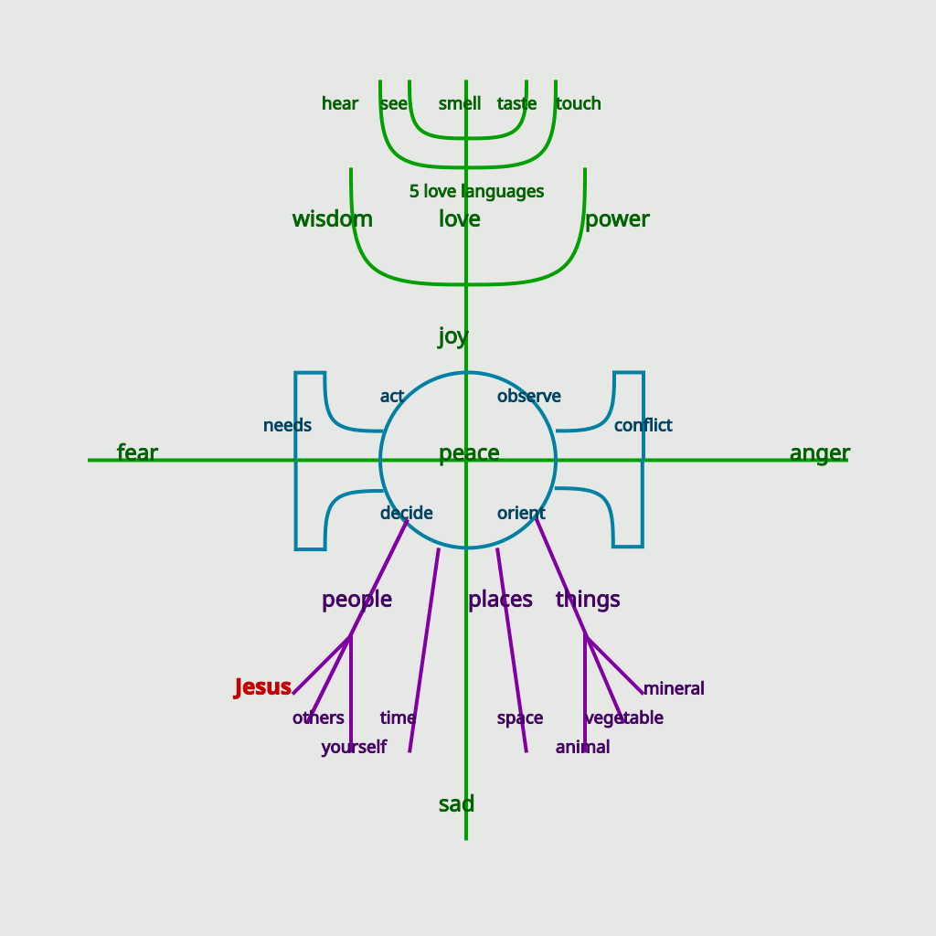

Slide 36
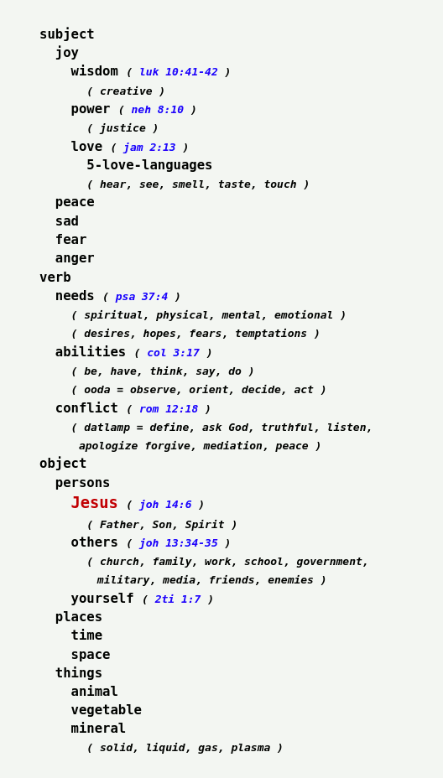

Slide 37
All chart images in one .zip released in cc0 license.
author: O. Philip Martin
web-link: https://www.opmartin.com/cc0/all-charts.zip
cc0-link: https://creativecommons.org/publicdomain/zero/1.0/
host-site: https://www.opmartin.com/
We believe the content which has been borrowed is covered under fair use.
- 7-big-questions chart includes quotes from Robert Jeffress (c) 2019,
and Erwin Lutzer (c) 2015
- chalkboard-temperaments chart contains free image from Daniel Reche from Pexels
- cosis chart contains images (c) by Kieran Heather
- instrument-classification chart contains free images from OpenClipart-Vectors, Clker-Free-Vector-Images, and davidswidjaja, via Pixabay
- trolls chart contains images (c) Dreamworks, and free quotes from Wikipedia
All other content is free to use under cc0.

